Slide 1
Containerization and Modern Virtualization
Unit

Slide 2
Problem Scenario: Application Deployment WITHOUT Docker
🏢 A software company builds a Student Management Web Application
Technologies: Python (Flask) and MySQL
Goal: Deploy the application from development to production

Slide 3
Development Phase (Without Docker)
👨‍💻 Developer builds the application on a local machine
Windows OS
Python 3.10
Specific library versions
✅ Application works perfectly on developer's system
🗣️ "It works on my machine!"

Slide 4
Testing Phase (Without Docker)
Tester runs the application on a different system
Linux OS
Python 3.8
Consequences:
❌ Application crashes
❌ Dependency and version mismatch errors
❌ Behavior differs from development environment

Slide 5
Deployment Phase (Without Docker)
🚀 System administrator deploys the app on production server
• Missing libraries
• Port conflicts with existing applications
❌ Manual installation required
❌ Deployment takes hours or days

Slide 6
Scaling and Maintenance Issues
📈 Number of users increases
❌ Difficult to replicate the setup on new servers
❌ Scaling is slow and error-prone
🔧 Updates break existing applications
❌ Rollback is difficult

Slide 7
Core Problems Without Docker
❌ Environment inconsistency
❌ Dependency conflicts
❌ Slow deployment
❌ Poor scalability
⚠The application depends on the environment, not just the code

Slide 8
Solution Scenario: Application Deployment WITH Docker
🏢 Same company, same Student Management Application
👨‍💻 Development Phase
Developer packages app + dependencies into a Docker Image
Environment is fixed and consistent
🧪 Testing Phase
• Tester runs the same Docker image
• Application works exactly the same
🚀 Deployment & Scaling
• Docker image runs on any server or cloud
• Scaling is fast and reliable
✅ Result: Build once, run everywhere

Slide 9
Why Docker Solves the Problem
✔ Same environment across Dev, Test, and Production
✔ No dependency or version mismatch
✔ Fast deployment and easy rollback
✔ Efficient use of system resources
✔ Supports modern microservices architecture

Slide 10
Before Docker vs After Docker
❌ BEFORE Docker
Environment mismatch
Manual dependency installation
Slow deployment
Hard to scale
High risk of failure
✅ AFTER Docker
Consistent environments
Application packaged with dependencies
Fast and automated deployment
Easy scaling
Reliable and repeatable

Slide 11
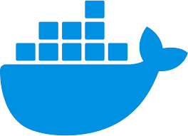
What is Docker?
Docker is an open platform for developing, shipping, and running applications
It separates applications from infrastructure, enabling faster software delivery
Reduces the gap between code development and production deployment

Slide 12
Containers in Docker
Applications run inside containers (lightweight, isolated environments)
Containers include:
Application code
Dependencies
Runtime environment
Run consistently across development, testing, and production

Slide 13
Docker Platform Capabilities
Build applications using containers
Containers become the unit of testing and distribution
Deploy applications:
On local servers
In the cloud
In hybrid environments
Manage the entire container lifecycle efficiently

Slide 14
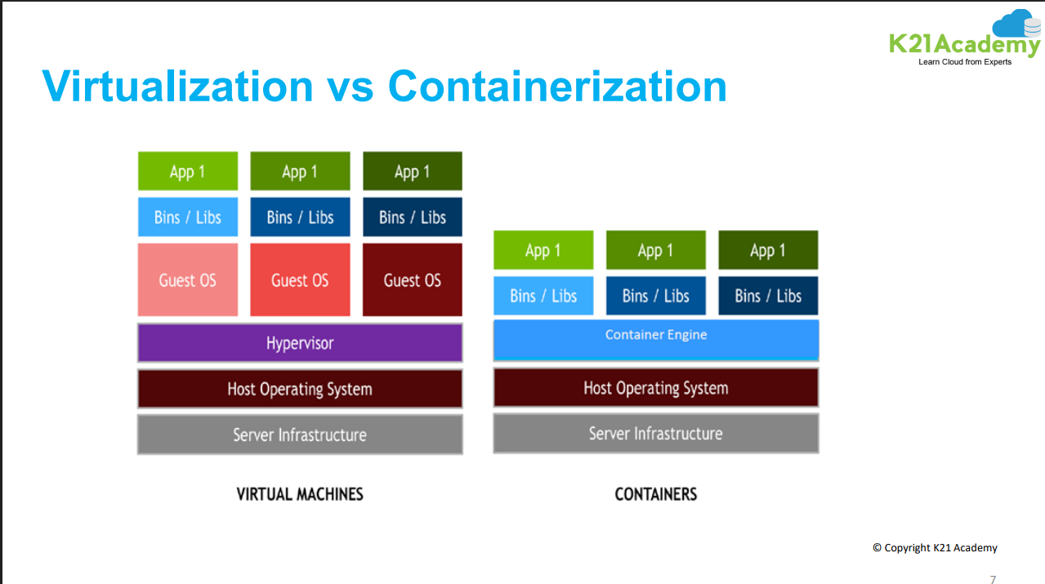

Slide 15
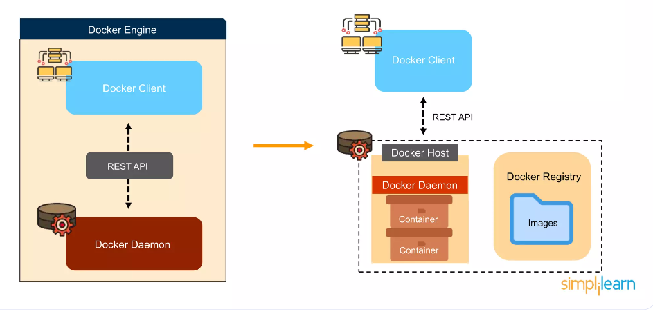
Docker Architecture

Slide 16
Docker Engine
The Docker Engine is the core component that enables Docker to run containers on a system. It follows a client-server architecture and is responsible for building, running, and managing Docker containers.
The Docker Engine Daemon (dockerd) runs in the background, listening to API requests and managing objects like images, containers, networks, and volumes.
The Docker Client (docker CLI) communicates with the daemon using a REST API. It provides the execution environment where Docker Images are instantiated into live containers.

Slide 17
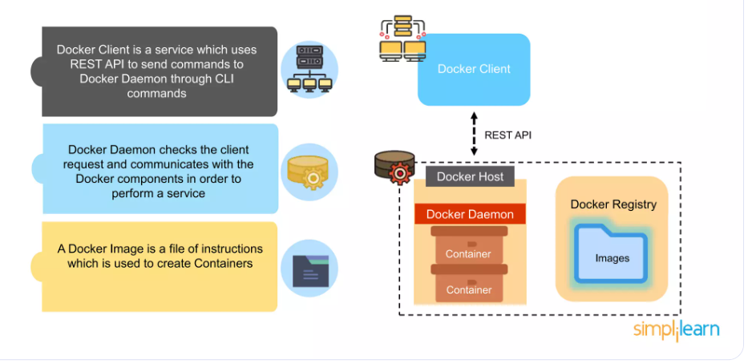
Docker Architecture

Slide 18
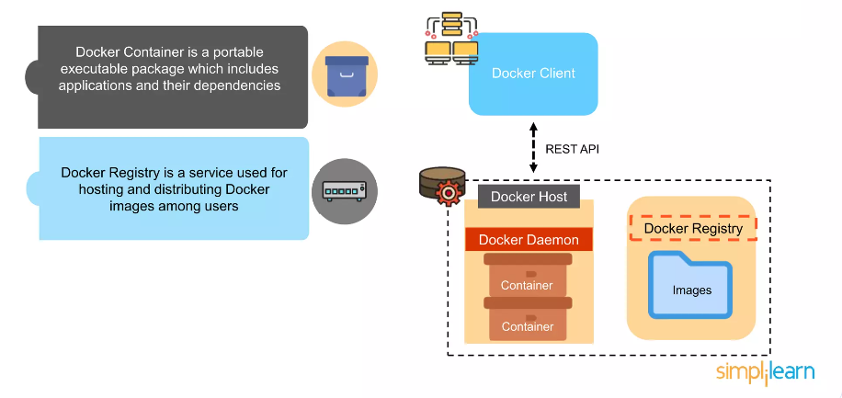
Docker Architecture

Slide 19
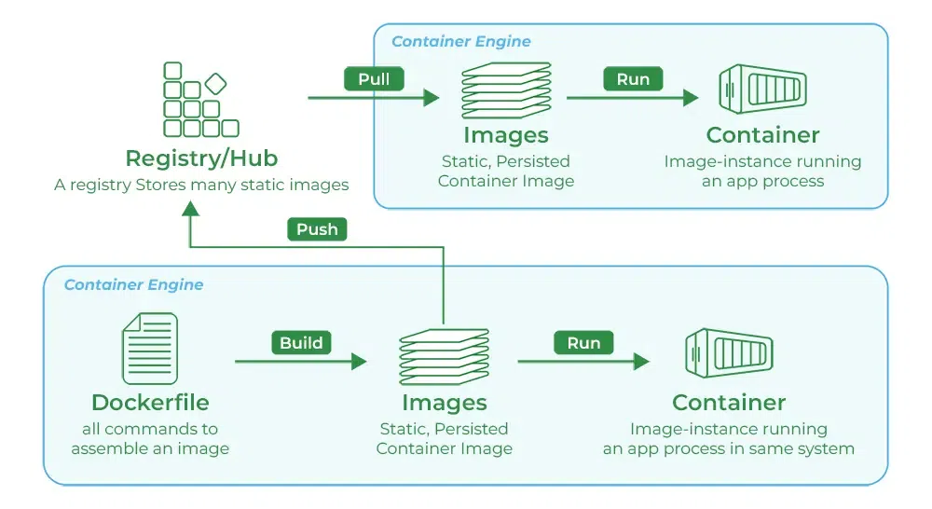
Docker Hub

Slide 20
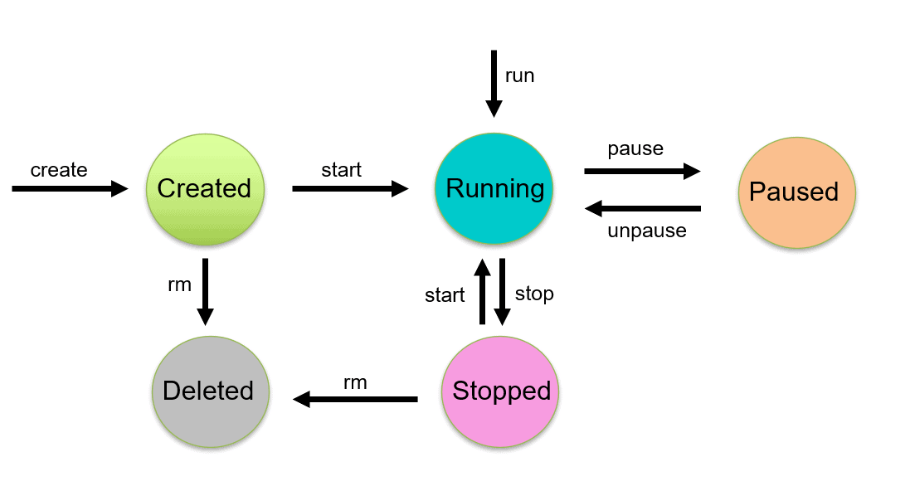
Container lifecycle

Slide 21
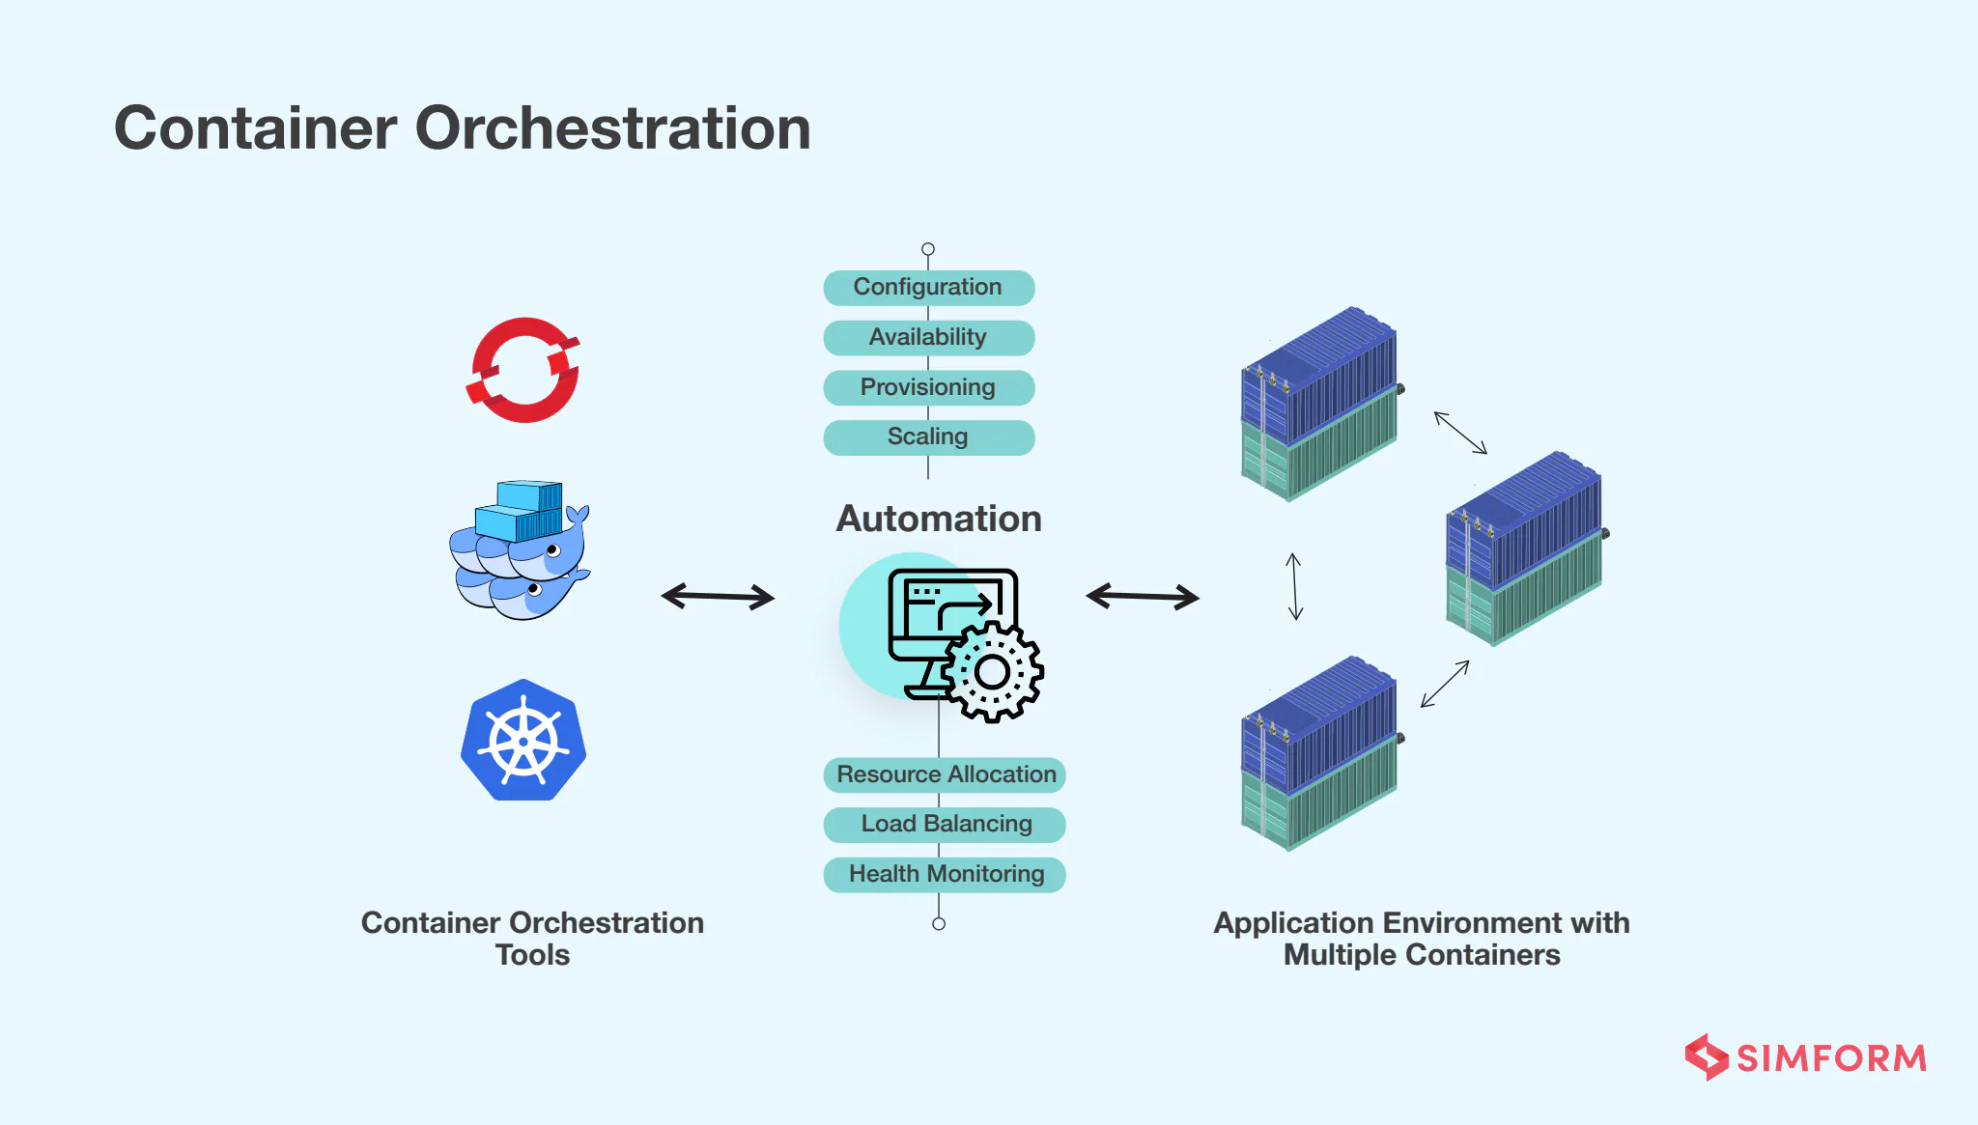
Container Orchestration
Container orchestration automates the deployment, scaling, and management of containerized applications.
It handles the lifecycle of containers — from provisioning to scaling and monitoring.

Slide 22
Challenges Without Orchestration
Manual container management is prone to errors at large scale.
Hard to track host utilization, perform updates, or handle failures.
✳️ What Orchestration Helps With
Automates container tasks
Ensures efficient use of resources
Simplifies deployment, scaling, and updates

Slide 23
Core Benefits of Container Orchestration
Business & Operational Benefits
✔️ Efficient Resource Management — optimizes CPU, memory, and storage. ✔️ Cost Savings — reduces human labor and infrastructure waste. ✔️ Greater Agility — faster deployment cycles. ✔️ Scalability — easy to scale apps up or down. ✔️ Better Security & Governance — isolation and fewer configuration errors.

